Slide 1
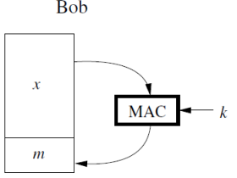
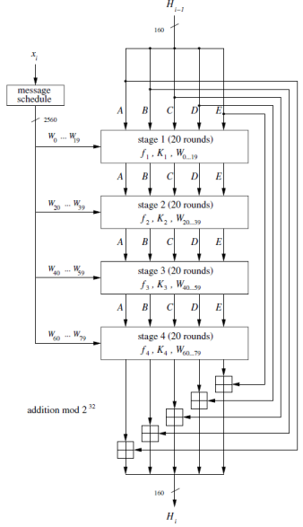
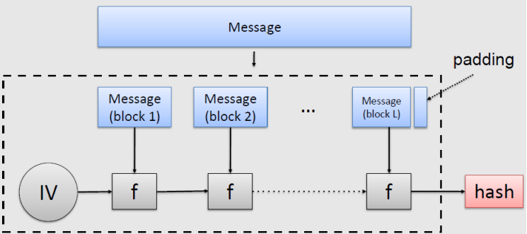

Properties:
Confidentiality: attacker is unable to decipher any secret data being transmitted between legitimate parties.
Integrity: attacker is unable to modify the data that is being transmitted between legitimate parties without being detected.
Availability: services provided by some party are resilient against interruptions caused by an attacker.
Privacy: identity of legitimate parties transmitting secret data to each other are kept confidential.
Authenticity: data originated from its purported source.
Non-repudiation: sender of data is provided with proof of delivery and recipient is provided with proof of sender’s identity, so neither can deny having processed the data.
Brute force times: n-bit key = 2^n attempts
32 bit-negligible time, 64 bit few days,
128 bit several decades, 256 unfeasible
Kerckhoff prinicple: cryptographic system should be secure even if the attacker knows all details about the system (encryption & decryption algo), except for the secret key.
a≡r mod m, if m divides a-r, 7 ≡ 7mod4
Substitution ciphers
Bijection: complete mapping between both alphabets.
Caesar cipher (shift cipher)
Shift all characters by k forward.
Encryption: y = (x+k)modn (n = keyspace)
Decryption: y = (x-k)modn
Use random mapping of characters to increase difficulty of cracking.
Attempts: n!
Frequency attack
Need to know the language, deduce shift using frequency plot.
Counters: misspell character, use dialects, randomly choose replacement for “e”, insert red herring characters.
Substitution of binary data
Substitute n-blocks at a time: (2^n)! Diff keys
Symmetric ciphers – same secret key for both encryption and decryption
Asymmetric (public key ciphers) - different keys for encryption and decryption, one key secret one key public.
Stream cipher – single bit of plaintext
Block cipher – fixed length n bit of plaintext
Modern ciphers use XOR, substitution, shift operation
Stream cipher: (bitwise addition modulo / XOR)
stream key, S, generated from key, k
Encryption: y[i] = (x[i] +s[i])mod2
Decryption: x[i] = (y[i] +s[i])mod2
XOR is perfectly balanced function, as it generates 50/50 of 1 or 0
Unconditional security: cannot be broken even with infinite computational resources
Computational security: best known algo to break it requires an arbitrarily large number. (most practical cryptoalgos)
OTP: ideal stream cipher (unconditional secure)
key stream s, is generated using a true random number generator
Key stream only known to legitimate communicating parties
Every key stream bit s[i] only used once
Brute force attack don’t work, each cipher text bit y[i] is a linear modulo 2 with 2 unknowns x[i] and s[i], cannot be solved assuming s[i] is random & not reused for other ciphertext bit. Stream cipher completely dependant on key stream
Do not reuse the key stream as:
y1 ⊕ y2 = e(x1) ⊕ e(x2) = (x1 ⊕ s) ⊕ (x2 ⊕ s) = x1 ⊕ x2
If alphabet used for x1 and x2 have same frequency distribution then possible to frequency attack.
If x1 or x2 known to attacker, the other msg can be derived
OTP pitfalls:
Needs a true RNG
Key stream needs to transmit over secure channel
Key stream bits cannot be reused, hence need key as long as plaintext.
Hash Functions: used to verify data integrity
Used to prevent man in the middle attacks
Attack by masking:
x1 = “buy100”, x2 “buy999”, mask = x1 ⊕ x2
y1 = e(x1), y2 = y1 ⊕ mask, x2 = y2 ⊕k
Mask: bitwise XOR of 2 plaintext strings
Attacker doesnt need to know key of OTP to modify plaintext
Hash functions:
Plaintext x padded and divided into blocks x[0], x[1],…,x[n].
Hash function operate on each block iteratively.
Output z = h(x) is the output of the last iteration.
Block size typically 128 (2^7) to 1024 (2^10) bits
Output is fixed size no matter the size of input plaintext.
Hash function should be computationally efficient
Computed digest, z, should be highly sensitive to input bits
Security requirement of hash functions:
Preimage resistance (one-wayness)
Hash needs to be one-way function, if given digest, it must be impossible to derive a matching message.
2nd preimage resistance (weak collision resistance)
Computationally infeasible to create another message x2 such that h(x1) = h(x2).
Difficult to find different msg that result in same hash.
Impossible to achieve non-existent weak collision due to pigeonhole principle, as mapping infinite input value to fixed output length of n, only 2^n possible outputs.
Output length of hash need to be sufficiently long.
Collision resistance (strong collision resistance)
Ensure that 2 different message don’t hash to same value
Finding collision (birthday paradox): O(2^n/2)
e^(-x) ≈ 1-x for x<<1, since i/2^n <<1
Recommended minimum hash output length: 160 bits
Finding collision and finding 2nd preimage is different, birthday attack doesn’t help with 2nd preimage.
2nd preimage starts with specific message m and attacker wants to find m’. Collision attack requires any 2 distinct messages that hash to same output.
Random oracle
Maps each unique input to a random output with uniform distribution. Even if x1 and x2 are correlated, outputs of each are completely uncorrelated.
Standard hash functions don’t have these properties.
Can construct message authentication codes with these hash functions.
MD5: dedicated hash function, specifically designed to operate as hash function
Iterative hash function (MD-based)
Divide input x into blocks of equal size (512-1024 bits)
Pad last block so it’s the same size as other blocks
Process block in order using compression function f & fixed size intermediate value h[i].
h[i] = f(h[i-1],x[i]), h[0] is IV h[n] is output z
Can hash message on the fly without having to store intermediate data.
Insecure hash function:
f(h[L-1],x[L]) = AES(h[L-1]⊕x[L]) = h[L]
Let x = (x1,x2), h[0] = 0,
h[1] = AES(h[0] ⊕x[1]), h[2] =AES(h[1] ⊕x[2])
x’ = (x[1]’x[2]’), x[1]’= h[1]⊕x[2], x[2]’ = h[2] ⊕h[1]⊕x2=h[2] ⊕x[1]⊕x[2]
h[1]’=AES(h[0] ⊕x[1]’)=AES(h[1] ⊕x[2])
h[2]’=AES(h[1]’ ⊕x[2]’)=AES(h[1] ⊕x[2]) => collision
Since x != x’ but h[2] = h[2]’, input msg diff but output same, failed 2nd preimage resistance.
MD5: 128 bit, obsolete
SHA-1: 160 bit,obsolete
SHA-2: 224,256,384,512 bit
Length extension attack
Attacker add 1 block x[n+1] and compute the hash z’
z’ = h(x’) = h[L+1] = f(h[L], x[L+1]) = f(z, x[L+1])
z’ != z but receiver thinks msg is authentic because z’ is valid hash value.
This works as MD based function provide information about h[n] after the first n blocks.
Fixes: concat entire plaintext with hash output h[i] before feeding it into compression function f, truncate final output of the hash function.
SHA-1 160 bit output
Input msg divide into block of 512 bits
Last block padded to have 512 bits, padding is a 1 followed by 0s followed by 64 bit binary representation of the length of the msg before padding.
Predefined IV is 160 bits long
Iterate 80 rounds
Hash function uses:
Commitment scheme
2 parties hash respective plaintext x1 and x2 and exchange them, z1,z2
2 parties exchange their actual plaintext, then rehash the plaintexts to check with their z1, z2
Can reverse engineer z1 sent in step 1 to find plaintext and send an optimal response if there is a small set of possible plaintexts. Need to make less predictable.
Salting
Add some bits of data to original message before running hash function.
Message authentication code (MAC)
Use shared secret key, combined with hash function.
Compute authentication tag m as function of message x and shared secret key k, m = MACk(x).
Send both x and m, receiver recompute authentication tag, m’, using received x.
Check if m = m’
Provides message authentication and message integrity as only 2 people possess the key, and only they can compute the tag.
Cannot provide non-repudiation, as no way to prove to neutral 3rd party that a message and the tag is from authorised person.
HMAC
Prefix MAC
m=MACk(x)=h(k//x), concatenate secret k infront of x
Attack prefix MAC (length extension attack)
m = MACk(x) = h(k || x1, …, xL) = hL = f(hL-1, xL)
Send x and m to other party
Attacker construct xOs = (x1, …, xL, xL+1) by adding new block xL+1 to original message.
Attacker send new m and new x to reciepient, reciepient falls for length extension attack.
Suffix MAC
m = MACk(x) = h(x || k), concat k behind x
Attack suffix MAC (2nd preimage attack)
Find 2nd preimage of original hash, such that h(xOs) = h(x), with xOs ≠ x
Then m = h(x || k) = h(xOs || k), send xOs and m over
20 32 bit words
Authentication: verifying the identity of the login request.
Knowledge-based auth: password, patterns, PINs
+: passwords change easily, user choose their own password
-: password forgotten, password reused, user makes weak password
Attacks: dictionary attack, rainbow table, hybrid attacks
Token-based auth: physical key, crypto token device, certificate based (TPM)
Biometric-based auth: fingerprint, retina, voiceprint
Multi-factor auth (MFA)
Defence in depth, inconvenient
Combination of: something you know + something you are + something you have
Initial value (fixed value)
Collision resistant compression function

Slide 2
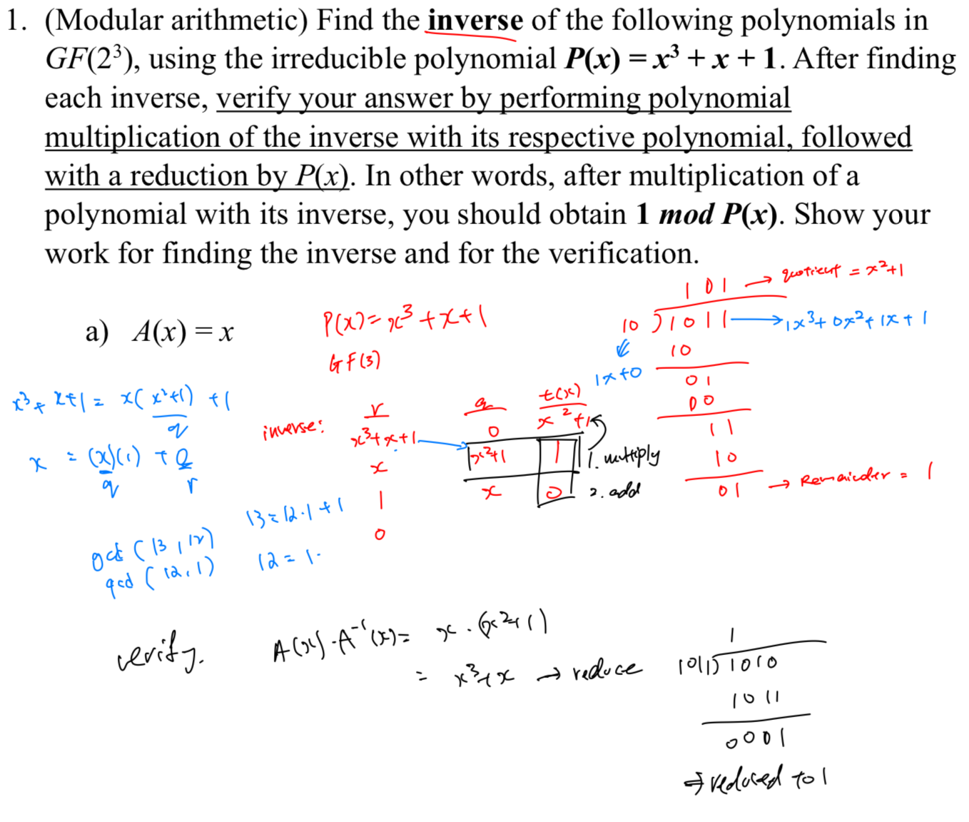
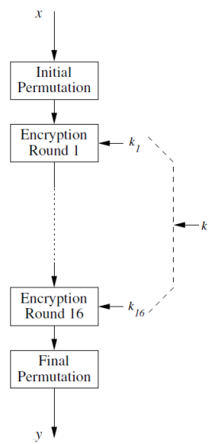
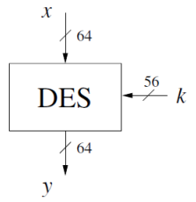
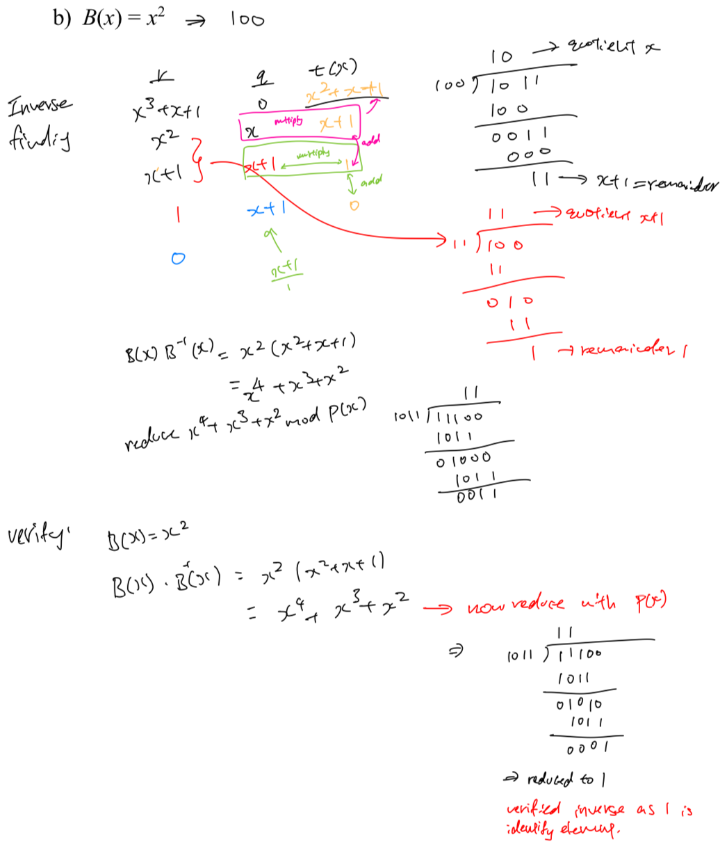
Block ciphers
Primitive operations: confusion + diffusion
Confusion: An encryption operation where the relationship between the key and ciphertext is obscured, use substitution operation.
Diffusion: spread the influence of 1 plaintext bit over many ciphertext bits, use bit permutation operations, changing 1 bit of plaintext changes half of the bits of ciphertext.
Data Encryption Standard (DES)
Encrypt 64 bit block of plaintext using 56 key bit
Symmetric cipher, same key for encrypt and decrypt
Each 64 bit block handled in 16 rounds.
Different round key used each round, K[i] generated from main key k, key schedule
Decryption uses round key k[16] for round 1, k[n-i] key
Uses a Feistal network, encryption and decryption are almost the same process, only reverse key schedule
Keys are listed as 64 bits as 8 bits are parity bits, actual key size is 56 bit
Steps:
Initial bitwise permutation IP of 64 bit plaintext x
Plaintext split into 2 32 bit halves, fed into the feistal network, consist of 16 round
Right half used as input to the f function, output of this function XORed with left half
Left and right half swapped.
Step 3 and 4 repeat in the next round.
L[i] = R[i-1]
R[i]=L[i-1]⊕f(R[i-1],k[i]), i=1…16
After round 16, 32 bit halves L[16] and R[16] are swapped again
Final bitwise permutation of IP^-1 of the resulting 64 bit value (IP^-1 is inverse of IP), output of 64 bit ciphertext
F-function
32 bit R[i-1] expanded to 48 bits, 16 of 32 bit are copied, some information is loss here hence non invertable.
48 bit result is XOR-ed with round key k[i] then separate into 8 6 bit blocks
Each 6 bit block is operated on by a S-box, resulting in a 4 bit value
4 bit blocks combined to a 32 bit value then permuted bitwise
S-box (6 bit input)
MSB and LSB select row, 4 inner bit select column
Key schedule
PC-1 operation, 64 bit key reduced to 56 bit by discarding every 8th bit (parity bits), remaining bits are permuted
Resulting 56 bit is split into 28 bit half C[i-1] and D[i-1], passed to transform I operation.
Each half is circular left shift by 1 or 2 bit depending on round i, resulting in C[i] and D[i]
Permute C[i] and D[i] using PC-2 operation, resulting in round key k[i]
Step 3 and 4 repeat to derive next round key
DES vulnerable to brute force attack due to small key length of 56 bit
Modular Arithmetic
XOR is a addition in Galois filed GF(2)
Algebraic structures:
Closure: for all possible input values from the set, output value is also an element of the set.
Associativity: order of evaluation of operations doesn’t change result of the expression
Definition: there is identity element i, that is subset of S such that f(i,a) = f(a,i)=a for all a
Invertibility: for each element a subset of S, a^-1 also exist
Group: G=(S,f) is a set of elements, S combines 2 elements of S to have the following property
Closed: f(a,b)=c, c is subset of S
Associative
There is an identity element i
For each a subset of S, there exist an inverse element a^-1 such that f(a,a^-1) = I
Ring: a group (S,f,w) that has 2nd operation w.
w must be closed, associative, must have identity element I, must be distributive over the operation f
Field: a ring such that all elements other than 0 form a multiplicative group with the operation ‘.’ and identity element 1. each non zero element has multiplicative inverse
When 2 operations are mixed, operation ‘.’ is distributive over ‘+’
Finite fields (galois fields)
A field with order m only exist if m is a prime number, m = p^n for some positive integer n and prime integer p. composite numbers cannot form finite field.
Extension field: a galois field GF(p^n) with n>1
Order of extension field is not prime
Not all non-zero integer will have inverse, cannot perform integer addition and multiplication modulo p^n on the elements of an extension field.
Contains n instances of a prime field GF(p)
Addition and subtraction in GF(2^n) extension field
A(x) = x^3 +x^2+1 , B(x) = x^2 +x
C(x) = A(x) + B(x) = A(x) – B(x) =
(1 ⊕ 0)x3 + (1 ⊕ 1)x2 + (0 ⊕ 1)x + (1 ⊕ 0) = x3 + x + 1
Multiplication in GF(2^n) field
C(x) ≡ A(x) ∙ B(x) mod P(x)
Do a regular polynomial multiplication of A(x) and B(x) to obtain C’(x)
The coefficients are in GF(2), so use AND for the multiplication of the terms of the polynomials A(x) and B(x); and XOR for the addition of the corresponding terms after multiplication
Do a polynomial division of the product C’(x) by the irreducible polynomial P(x)
Keep the remainder of the polynomial division, this is our desired result C(x)
C’(x) = A(x) . B(X) = (x^3 +x^2 +1)(x^2+x)
=x^5 + x^4 + x^2 + x^4 + x^3 + x = x^5 + x^3 + x^2 + x

